Slide 1
A change of perspective: The importance of evaluating domain specific assumptions for robust model development
Vihanga Gunadasa
Supervised by
Prof. Glenda Wardle, Prof. Robert Kohn, Dr. Aaron Greenville
Australasian Applied Statistics Conference 2022
RACV Inverloch Resort, VIC, AUS
I acknowledge the traditional owners of the land on which we meet and pay respect to the Elders past, present and emerging. I recognize their enduring bond to the land and waters and extend my heartiest gratitude to them for protecting this coastline and its ecosystems since time immemorial.

Slide 2
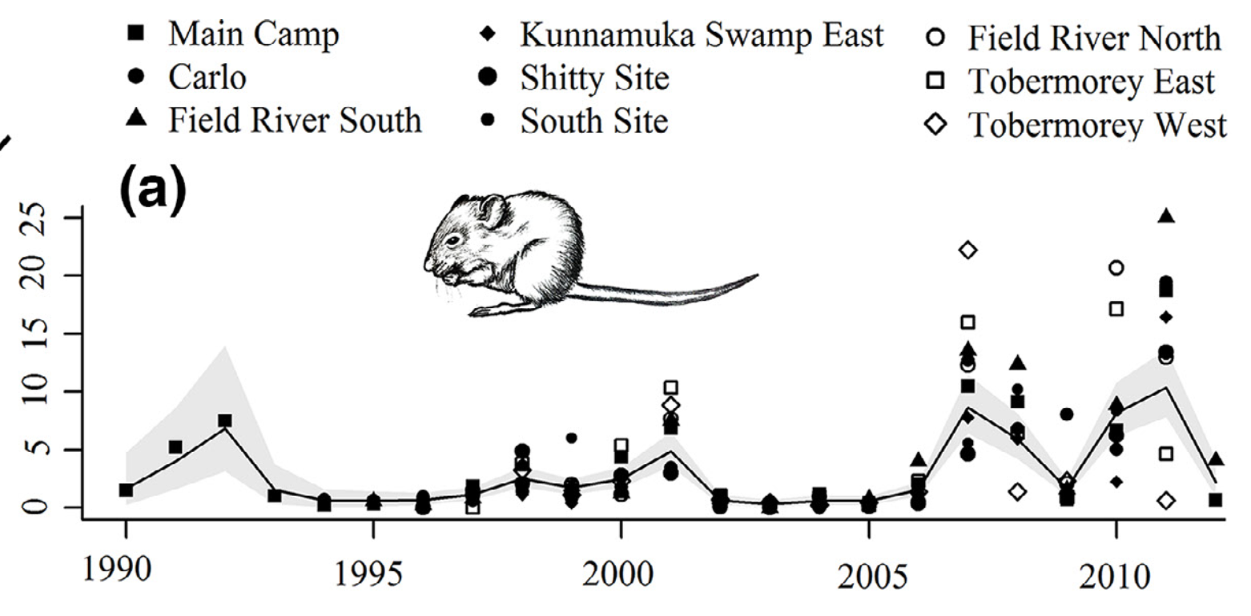
Greenville et al. (2016). Population dynamics of desert mammals: similarities and contrasts within a multispecies assemblage. Ecosphere, 7(5), e01343.
Captures
Captured Time Series data
Population abundance data are time series
Change over time
Vary according to where the species live due to resources, predators and habitats
Notes:
Population abundance data are time series, so we understand that,
numbers of individuals will change over time and vary according to where the species live due to resources, predators and habitats

Slide 3
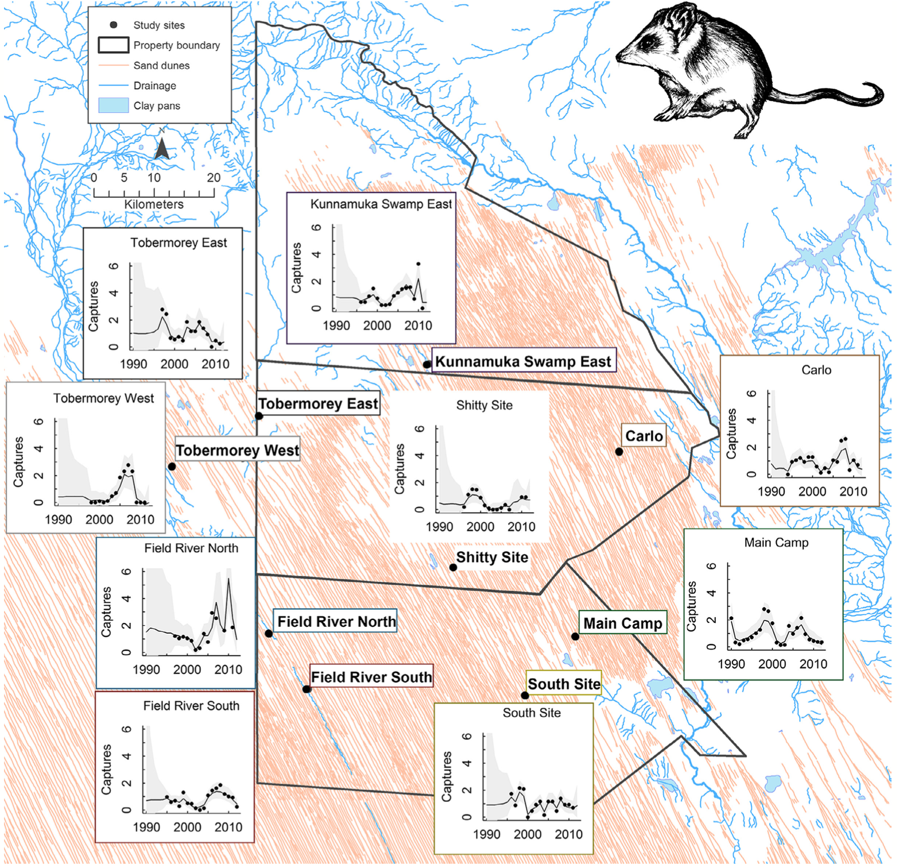
Spatially Modelled Time Series data
We can model individual abundance over different populations spatially.
What about the response of each species to changing environmental conditions?
To understand the system ➠ investigate the assumptions of the model
Greenville et al. (2016). Population dynamics of desert mammals: similarities and contrasts within a multispecies assemblage. Ecosphere, 7(5), e01343.
Notes:
Therefore, we can model individual abundance over different populations spatially.
When doing so, we need to keep in mind that the response of each species to changing environmental conditions is different.
Therefore, in order to understand the system, it is required to investigate the assumptions of the mode – in this case the ecological assumptions

Slide 4
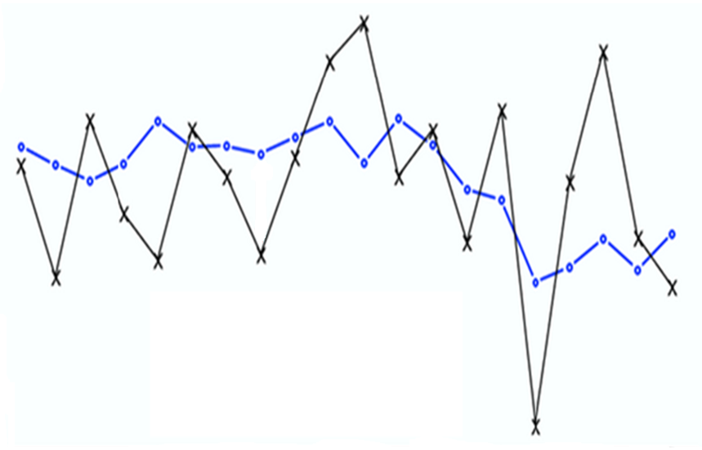
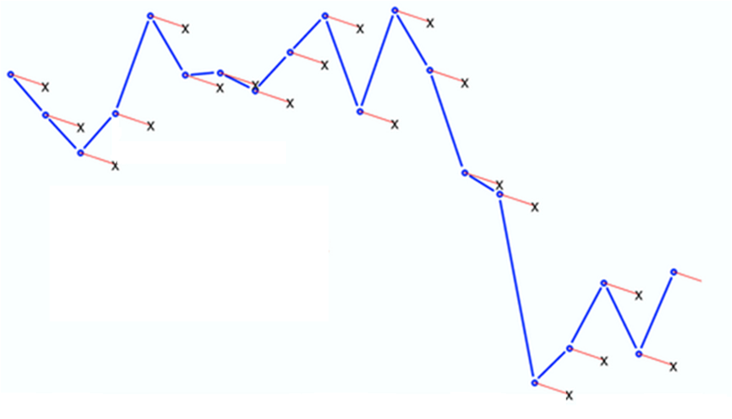
Observation error
Process error
The observation error is the difference between the true value and the observed value at time t
The process error is the difference between the expected value and the actual value at time t
True value
True value
Log(N)
Log(N)
Expected value
Observed value
t
t
NAs?
Holmes et al. (2012). MARSS: Multivariate autoregressive state-space models for analyzing time-series data
Notes:
When analysing actual field-collected data, we deal with different types of uncertainties.
And for ecological time series, we come across 2 main types .
First, is the observation error that occurs due to sampling techniques. This is the difference between the true and the observed value of the series.
Next, is the process error that occurs due to environmental variability. Similar to the observation error this is the difference between the usual expected value of the series and the actual value.
Apart from these, the other issue with ecological time series is the missing observations due to logistical and financial constraints.

Slide 5
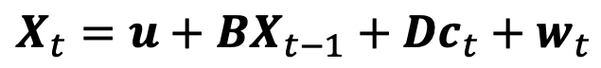
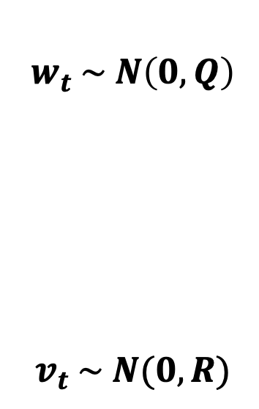
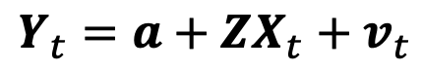
Multivariate Auto-regressive State Space (MARSS) Model
Based off the Gompertz population growth model that assumes exponential growth
Process Equation
Trend of the sub-population
Potential covariates
$$w_{t} \sim N\left(0, Q\right)$$
$$v_{t} \sim N(0, R)$$
$$X_{t}={u+BX}_{t−1}+{Dc}_{t}+w_{t}$$
Density dependance & Species interactions
Process error
True log population abundance
Observation Equation
Mean bias between sites
$$Y_{t}={a+ZX}_{t}+v_{t}$$
Observation error
Observed log population abundance
Relates each observation time series to a different state process
Holmes et al. (2012). MARSS: Multivariate autoregressive state-space models for analyzing time-series data
Notes:
In order to solve these issues, ecologists have used Multivariate Autoregressive State Space models as it has an observation and a process equation.
The process equation predicts the true abundance at the current time making use of the previous abundance, species interaction and other covariates in the environment. The wt represents the process error.
Similarly, the observation equation models the observed abundance at time t as a function of the true value at that time and vt represents the observation error.
This model also deals with missing values by estimating the gaps in the observations.

Slide 6
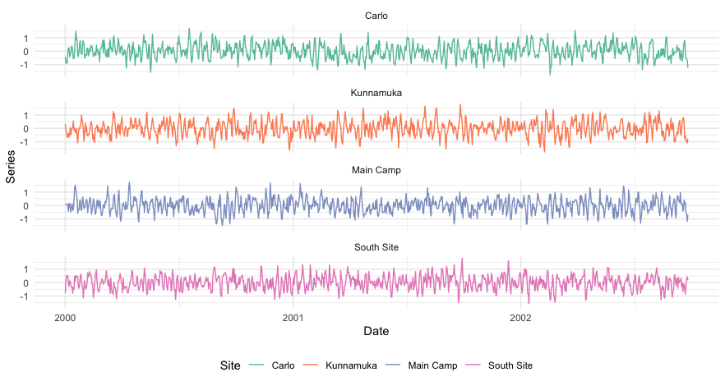
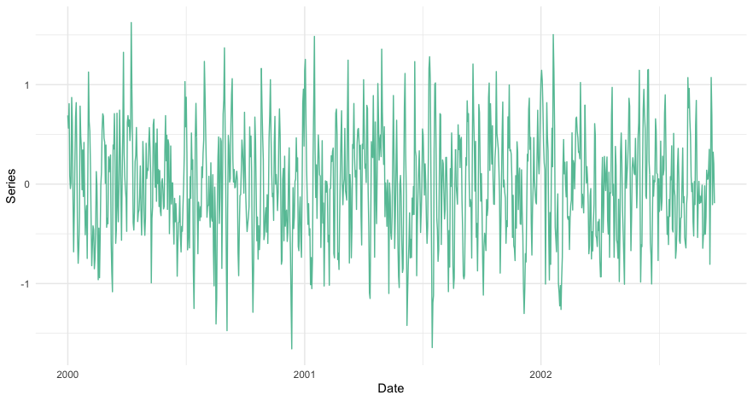
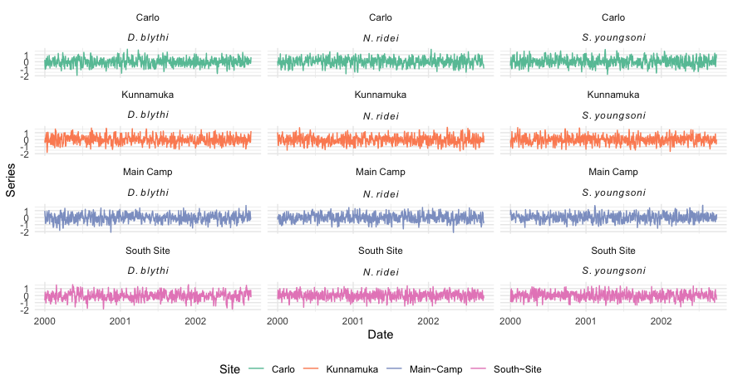
What type of data do we need?
A long time series data set
A long time series data set
Observations collected across many sites
Few species that contrast in their dynamics
A long time series data set
Observations collected across many sites
Notes:
Moving on, if we want to model the population abundance of species and understand the system what type of data do we need?
We need a long time series dataset which is also known as longitudinal data
Observations collected across many sites to accompany the spatial structure
And few different contrasting species to observe how they behave for varying environmental conditions.

Slide 7
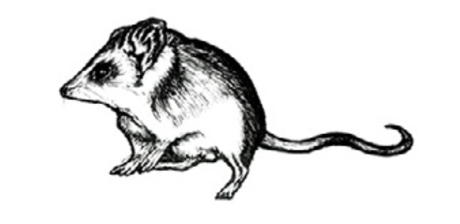
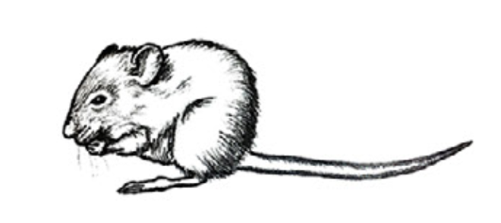
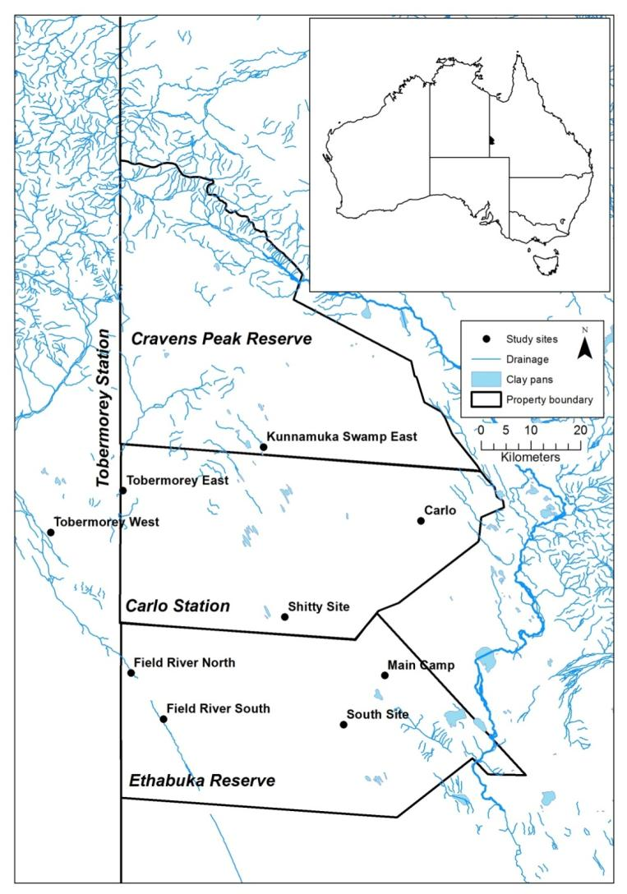
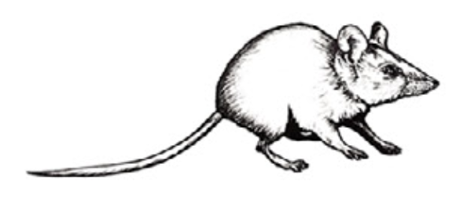
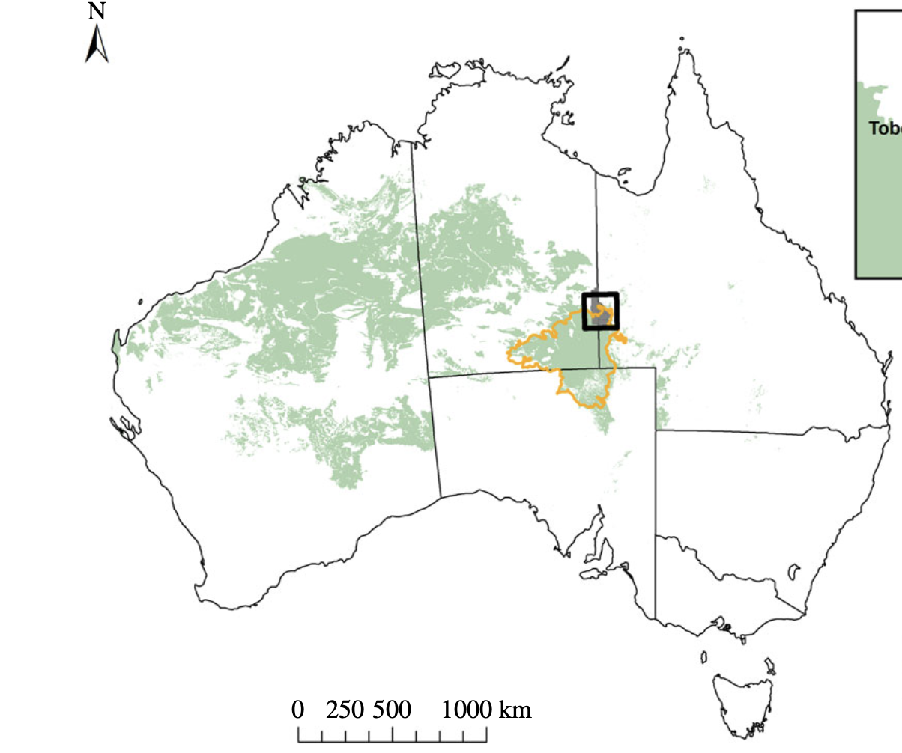
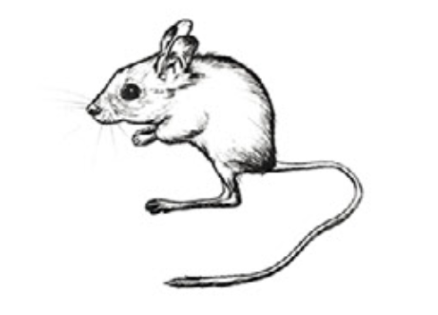
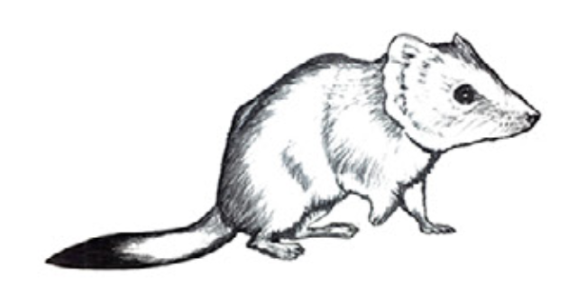
Case Study
Bayesian MARSS Model
Inference on Population abundance
Captures
20+ years
Greenville et al. (2016). Population dynamics of desert mammals: similarities and contrasts within a multispecies assemblage. Ecosphere, 7(5), e01343.
Notes:
To explore the time series modeling in depth we use a case study conducted by the Desert Ecology Research Group at the University of Sydney: Aaron Greenville, Glenda Wardle and Chris Dickman. Based on their long-term field surveys they modelled the abundance of 5 different small mammal species; rodents and dasyurids, at 9 different spatially separated sites in the Simpson Desert using over 20 years of annual data. They built a Bayesian MARSS model to make inferences on population abundance.

Slide 8
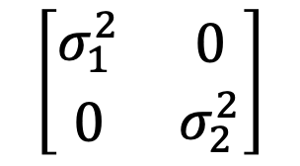
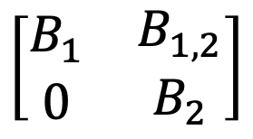
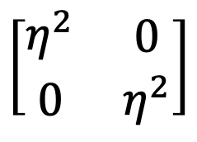
Case Study
How did they deal with missing values?
RJAGS (Bayesian Graphical Models using MCMC) package in R Software was used for modelling
Didn’t allow proper imputation of NAs
Skipped over missing values
Reduced the number of observations used in modelling
Restrictions on Ecological Assumptions
Process Error Variance – Q
Observation Error Variance – R
Density Dependence - B
$$\left[\begin{matrix}σ_{1}^{2} & \begin{matrix}0\end{matrix} \\ \begin{matrix}0\end{matrix} & \begin{matrix}\begin{matrix}σ_{2}^{2}\end{matrix}\end{matrix}\end{matrix}\right]$$
unique variances and year-to-year population changes are uncorrelated
$$\left[\begin{matrix}η^{2} & \begin{matrix}0\end{matrix} \\ \begin{matrix}0\end{matrix} & \begin{matrix}\begin{matrix}η^{2}\end{matrix}\end{matrix}\end{matrix}\right]$$
identical variances and
uncorrelated errors
$$\left[\begin{matrix}B_{1} & \begin{matrix}B_{1,2}\end{matrix} \\ \begin{matrix}0\end{matrix} & \begin{matrix}\begin{matrix}B_{2}\end{matrix}\end{matrix}\end{matrix}\right]$$
one-way
interaction between species
Martyn Plummer (2021). rjags: Bayesian Graphical Models using MCMC. R package version 4-12. https://CRAN.R-project.org/package=rjags

Slide 9

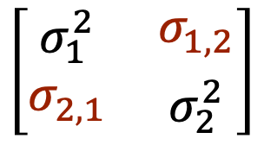
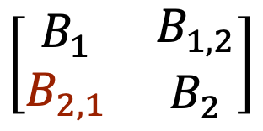
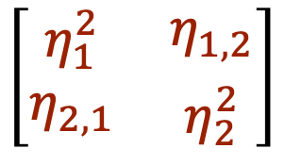
Our Goal
Missing value imputation
Use MICE (Multivariate Imputation by Chained Equations) package in R Software
Impute missing values with plausible data values
Values are drawn from a distribution specifically designed for each missing datapoint.
Creates multiple imputations ➞ accounts for the statistical uncertainty in the imputations
Used the complete dataset in modelling
Relaxations on Ecological Assumptions
Process Error Variance – Q
Observation Error Variance – R
Density Dependence - B
$$\left[\begin{matrix}σ_{1}^{2} & \begin{matrix}σ_{1,2}\end{matrix} \\ \begin{matrix}σ_{2,1}\end{matrix} & \begin{matrix}\begin{matrix}σ_{2}^{2}\end{matrix}\end{matrix}\end{matrix}\right]$$
variances all different and year-to-year
population changes covary
$$\left[\begin{matrix}η_{1}^{2} & \begin{matrix}η_{1,2}\end{matrix} \\ \begin{matrix}η_{2,1}\end{matrix} & \begin{matrix}\begin{matrix}η_{2}^{2}\end{matrix}\end{matrix}\end{matrix}\right]$$
unequal variances and
correlated errors
$$\left[\begin{matrix}B_{1} & \begin{matrix}B_{1,2}\end{matrix} \\ \begin{matrix}B_{2,1}\end{matrix} & \begin{matrix}\begin{matrix}B_{2}\end{matrix}\end{matrix}\end{matrix}\right]$$
two-way
interaction between species
Azur MJ, Stuart EA, Frangakis C, Leaf PJ. Multiple imputation by chained equations: what is it and how does it work? Int J Methods Psychiatr Res. 2011 Mar;20(1):40-9.
Notes:
GW – love the coincidence of the name MICE to model mice and other small mammals.
Make sure you have time to explain this method properly in the talk.
From the Azur paper
Missing data are a common problem in psychiatric research. Multivariate imputation by chained equations (MICE), sometimes called “fully conditional specification” or “sequential regression multiple imputation” has emerged in the statistical literature as one principled method of addressing missing data. Creating multiple imputations, as opposed to single imputations, accounts for the statistical uncertainty in the imputations. In addition, the chained equations approach is very flexible and can handle variables of varying types (e.g. continuous or binary) as well as complexities such as bounds or survey skip patterns.
MICE steps
The chained equation process can be broken down into four general steps:
Step 1: A simple imputation, such as imputing the mean, is performed for every missing value in the dataset. These mean imputations can be thought of as “place holders.”
Step 2: The “place holder” mean imputations for one variable (“var”) are set back to missing.
Step 3: The observed values from the variable “var” in Step 2 are regressed on the other variables in the imputation model, which may or may not consist of all of the variables in the dataset. In other words, “var” is the dependent variable in a regression model and all the other variables are independent variables in the regression model. These regression models operate under the same assumptions that one would make when performing linear, logistic, or Poison regression models outside of the context of imputing missing data.
Step 4: The missing values for “var” are then replaced with predictions (imputations) from the regression model. When “var” is subsequently used as an independent variable in the regression models for other variables, both the observed and these imputed values will be used.
Step 5: Steps 2–4 are then repeated for each variable that has missing data. The cycling through each of the variables constitutes one iteration or “cycle.” At the end of one cycle all of the missing values have been replaced with predictions from regressions that reflect the relationships observed in the data.
Step 6: Steps 2–4 are repeated for a number of cycles, with the imputations being updated at each cycle.
At the end of these cycles the final imputations are retained, resulting in one imputed dataset. Generally, 10 cycles are performed (Raghunathan et al., 2002); however, research is needed to identify the optimal number of cycles when imputing data under different conditions. The idea is that by the end of the cycles the distribution of the parameters governing the imputations (e.g. the coefficients in the regression models) should have converged in the sense of becoming stable. This will, for example, avoid dependence on the order in which the variables are imputed.
FOR DISCUSSION
While MICE offers great advantage over other missing data techniques in terms of its flexibility, a primary disadvantage is that MICE does not have the same theoretical justification as other imputation approaches. In particular, fitting a series of conditional distributions, as is done using the series of regression models, may not be consistent with a proper joint distribution.

Slide 10
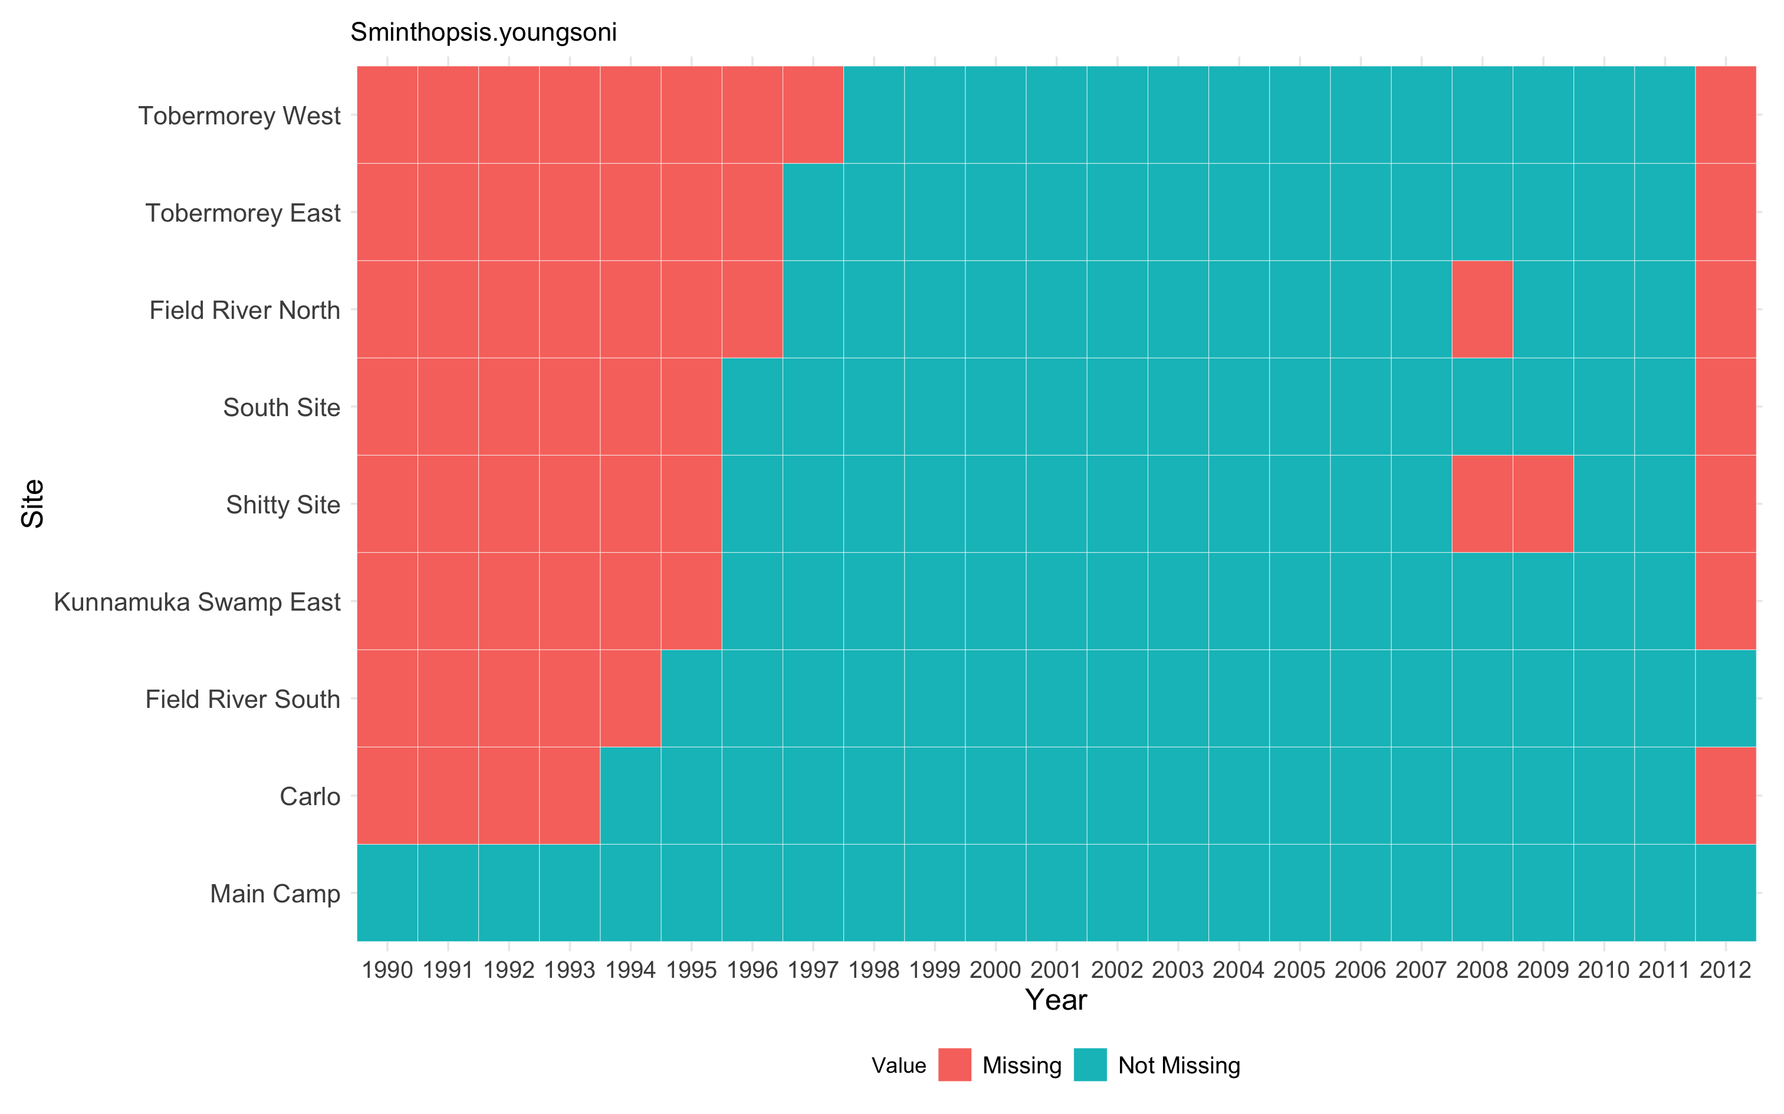
Pipeline
S.youngsoni
S. youngsoni
Sminthopsis youngsoni Lesser hairy-footed dunnart
Site | No. of Missing Values | As a % of the complete dataset
Main Camp | 0 | 0
Carlo | 5 | 22
Shitty Site | 9 | 40
NA imputation via
MICE
Compare Performance
Metrics
Number of observations = 23
Mean Absolute Error (MAE)
Model Fit
Akaike Information Criterion
corrected (AICc)
Relaxed Q, R, B
Relaxed Q, R

Slide 11
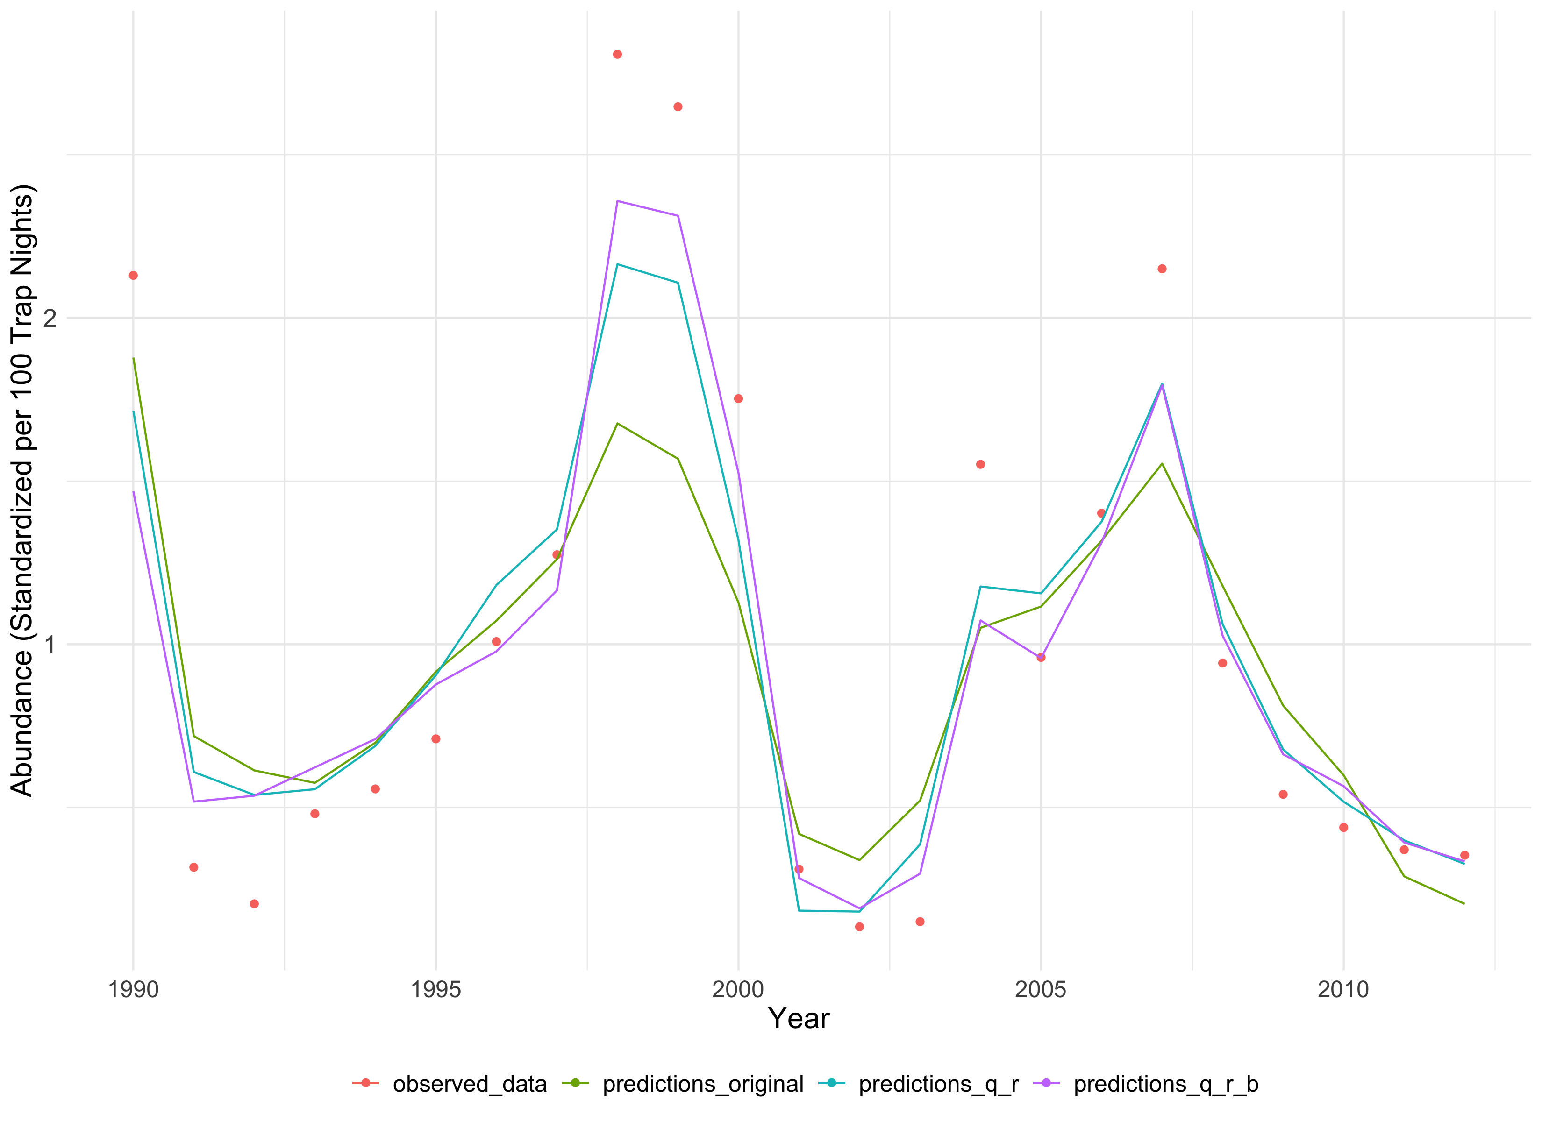
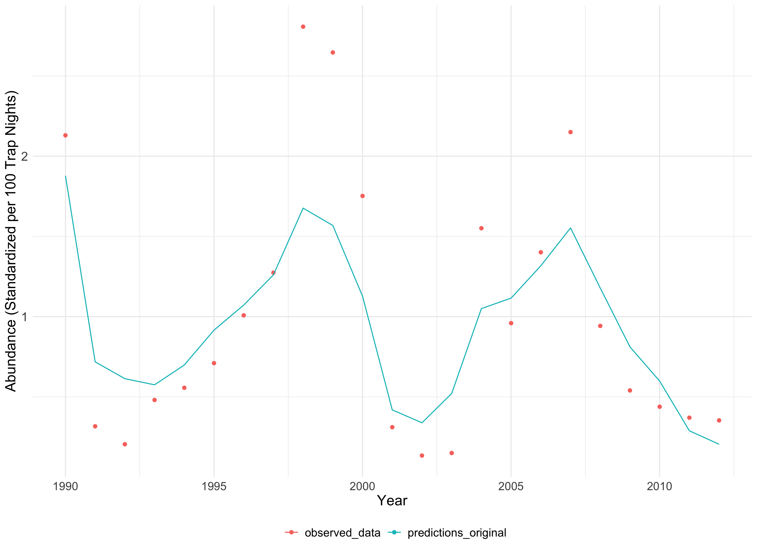
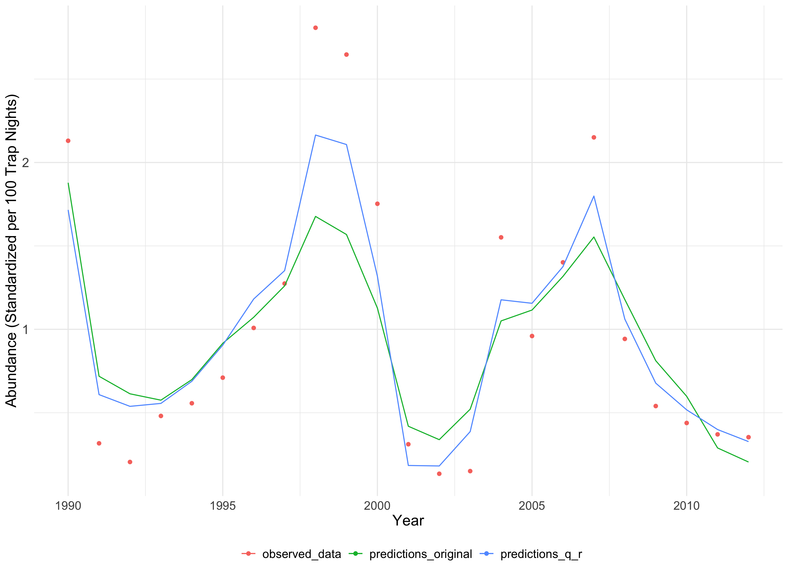
Results – Main Camp
Model | MAE
Original | 0.319
Model | MAE
Original | 0.319
Relaxed_Q_R | 0.220
Model | MAE
Original | 0.319
Relaxed_Q_R | 0.220
Relaxed_Q_R_B | 0.189

Slide 12
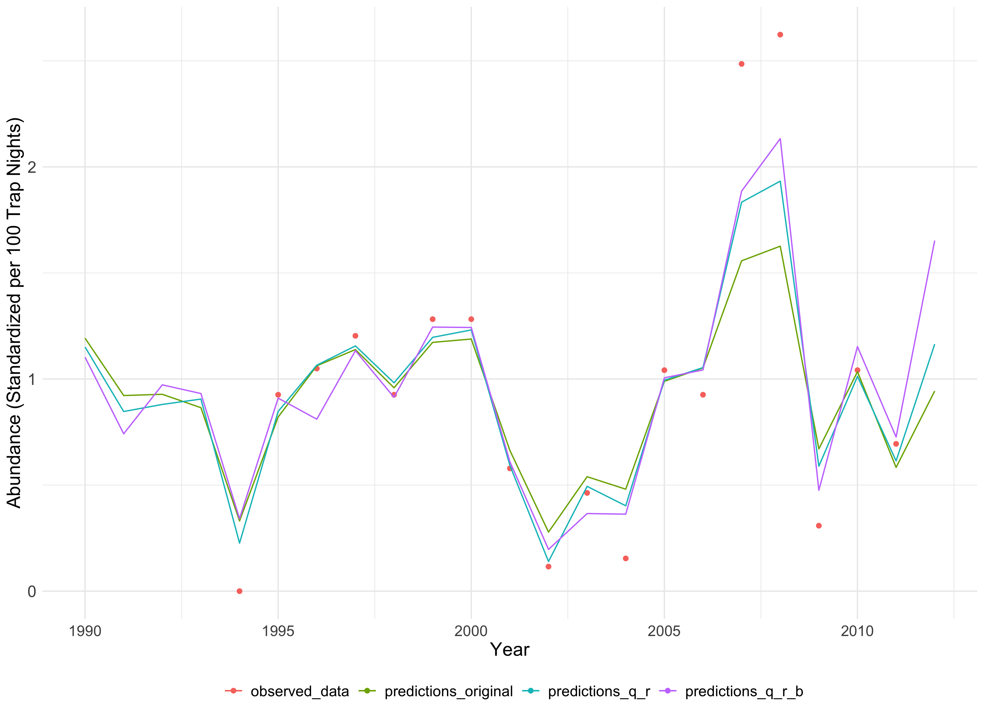
Results – Carlo
Model | MAE
Original | 0.221
Relaxed_Q_R | 0.155
Relaxed_Q_R_B | 0.151

Slide 13
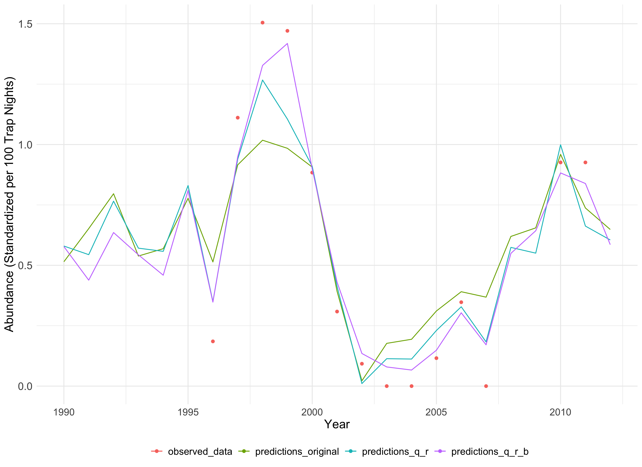
Results – Shitty Site
Model | MAE
Original | 0.205
Relaxed_Q_R | 0.145
Relaxed_Q_R_B | 0.090

Slide 14
Model Comparison
Model | AICc | No. of Parameters
Original | 811.5543 | 49
Relaxed_Q_R | 6867.692 | 367
Relaxed_Q_R_B | -2227.233 | 664
Overfits the observations
What would you select from Original Model and Relaxed_Q_R Model?
Notes:
GW – what are you going to conclude from this?

Slide 15
Summary
Using a method to impute NAs, didn’t lead to more robust conclusions.
By having more general model assumptions, we can substitute more species without changing model structure.
But, new models are at risk by estimating so many more parameters. If these do not apply to the biology of the system, why would we include them?
Even by restricting domain assumptions we can capture the process

Slide 16
What’s next?
Captures
2012 – 2022 & continuing
20+ years
Why?
NEAR-TERM ITERATIVE FORECASTING FRAMEWORK
Support in managing species at risk by anticipating the dynamic changes and
mitigating threats accordingly
To improve statistical robustness of the modelling for any ecological system
Notes:
For last slide need to foreshadow that the data collection has been ongoing and so you will have data from 2012 - 2022 and more to model and forecast.
Also add some statement in what you say about why we want to forecast or model mammal population abundance more robustly. Also add that this is a case study to improve statistical robustness of the modelling for any ecological system.

Slide 17

Thank you!

